Slide 1
LECTURE 9
Blueprints in Action 1

Slide 2
LECTURE GOALS AND OUTCOMES
The goals of this lecture are to
Present transforms
Explain world coordinates
Demonstrate the difference between relative and world-based transforms
Show how to use vector operations
Show some vector functions
By the end of this lecture you will be able to
Use vectors to represent location and movement
Distinguish between world and local coordinates
Use vector operations and functions

Slide 3
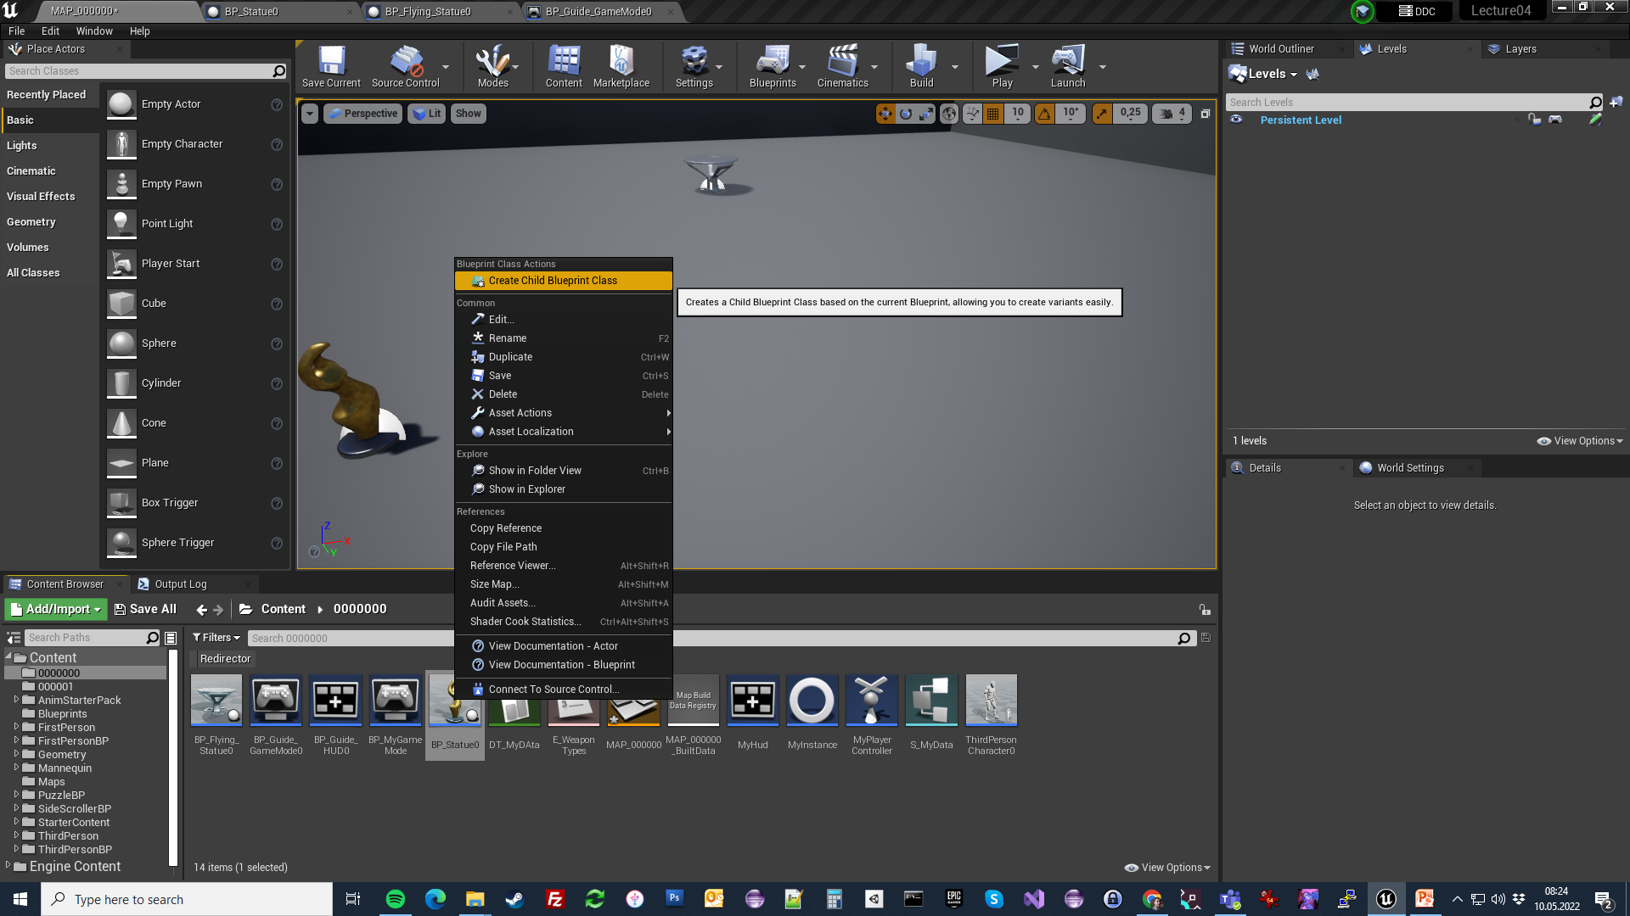
INHERITANCE
A «Child Blueprint» is a blueprint which has inherited the functionality of another «Parent» blueprint. And this functionality is called «Inheritance»
Creating a child blueprint out of an existing blueprint has many advantages and also good modular programming exercise.
Using child blueprint provides you:
Creating Variants Easly
Re-use already written code and functionality.
Makes you code/blueprints easy to manage and navigate.

Slide 4
MATH

Slide 5
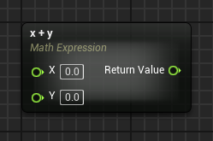
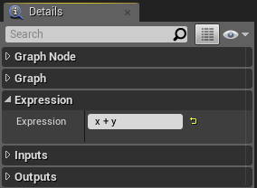
MATH EXPRESSION NODE
The Math Expression node is a special type of node that generates a subgraph using a specified mathematical expression.
To use it, select “Add Math Expression…” in the context menu. The images on the right show a simple example using the expression “x + y”.
Input
Expression: The expression that will be analyzed.
Parameters defined in “Expression”: For each variable name in the expression, a new input parameter is generated.
Output
Return Value: Outputs the result of the expression.

Slide 6
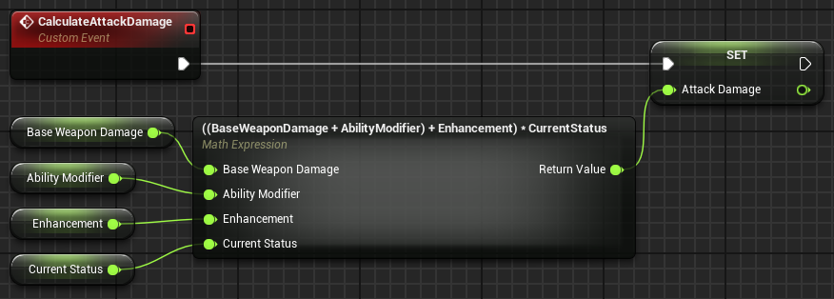
MATH EXPRESSION NODE:
EXAMPLE
In the example on the right, the CalculateAttackDamage event calculates attack damage and stores the result in a variable. It uses a Math Expression node with the following expression:
((BaseWeaponDamage + AbilityModifier) + Enhancement) * CurrentStatus
The input parameters were generated based on this expression.

Slide 7
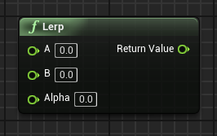
LERP NODE
“Lerp” is short for “linear interpolation”. This function node generates a value within a range of two specified values, based on the value of the Alpha parameter.
Input
A: Takes in a float value that represents the lowest value that can be returned.
B: Takes in a float value that represents the highest value that can be returned.
Alpha: Takes in a float value between “0” and “1”. If the value is “0”, it returns the lowest value; if the value is “1”, it returns the highest value.
Output
Return Value: Outputs a float value between the values of the A and B parameters that is dependent on the value of the Alpha parameter.

Slide 8
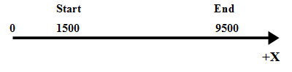
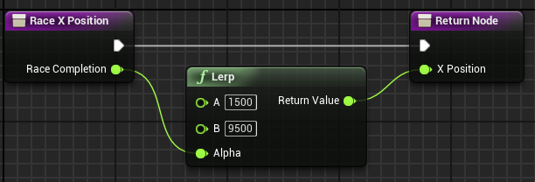
LERP NODE:
EXAMPLE
In the example to the right, there is a race that occurs along the X axis. The race starts at the position X = 1500 and ends at the position X = 9500.
The Lerp node is used with the value of parameter A set at “1500” and parameter B set at “9500”. The Alpha parameter takes in a value between “0” and “1” that indicates how much of the race has been completed and returns a corresponding value for the X position.
If the value of the Alpha parameter is set to “0.5”, the return value will be “5500”, representing the middle of the race.

Slide 9
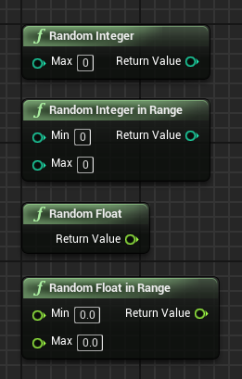
RANDOM NUMBERS
There are random number functions that return a random value. The main ones are listed below:
Random Integer: Returns an integer value between “0” and “Max – 1”.
Random Integer in Range: Returns an integer value between “Min” and “Max”.
Random Float: Returns a float value between “0” and “1”.
Random Float in Range: Returns a float value between “Min” and “Max”.

Slide 10
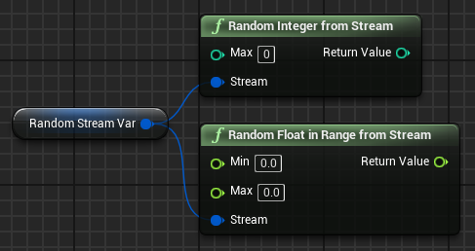
RANDOM NUMBERS FROM STREAMS
It is possible to create a sequence of repeatable random numbers using a Random Stream variable.
To do this, create a variable of type “Random Stream”. Set the Initial Seed property in the Default Value section of the Details panel for the variable.
The value of the Initial Seed property will define the sequence of the random numbers.
The image on the right shows some random number functions that use a Random Stream variable.

Slide 11
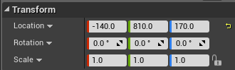
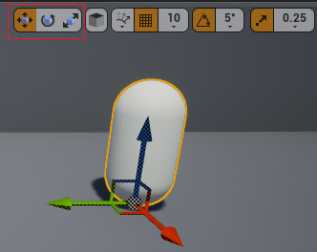
TRANSFORM
Every Actor has three Transform properties that represent its world location, rotation, and scale, as shown in the top image on the right.
You can modify the Actor’s transforms using the Details panel or by using gizmos in the Level Editor.
In the Level Editor, there are buttons to select the type of transformation to apply to an Actor. The bottom image on the right shows those buttons highlighted in red.

Slide 12
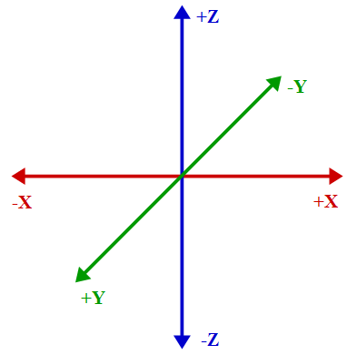
WORLD COORDINATES
3D space is represented by three axes: X, Y, and Z.
There are different ways to organize these axes. Unreal Engine uses the approach displayed in the figure on the right.
Any position in 3D space can be represented using a set of values for X, Y, and Z indicating the position on each axis. These values are stored in the Location variable, which is part of the transform struct, and they determine what is known as world location.

Slide 13
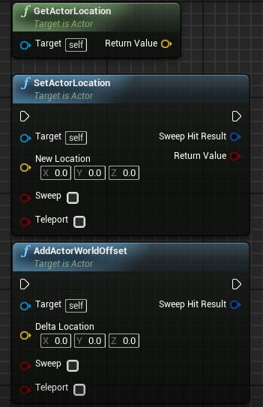
LOCATION FUNCTIONS
By default, an Unreal unit (uu) equals 1 centimeter. To use the values of the Location variable in a Blueprint, the following functions can be used:
GetActorLocation: Returns the current position of the Actor.
SetActorLocation: Sets a new position for the Actor.
AddActorWorldOffset: Uses the values of the Delta Location parameter to modify the current position of the Actor.

Slide 14
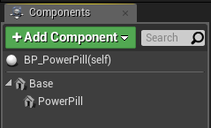
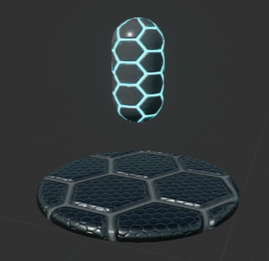
RELATIVE TRANSFORM
There is another concept known as relative transform.
To understand this concept, take as an example a Blueprint with two components, a Base component, which is the root component, and a PowerPill component, as seen in the image on the right.
The Location values of the PowerPill component are X = “0”, Y = “0”, Z = “70”.
The position of the PowerPill component is relative to that of the root component, so when the Base component is moved, the PowerPill component will follow the root component’s movement, as it must always be located at a distance from the Base component of 70 cm on the Z axis.

Slide 15
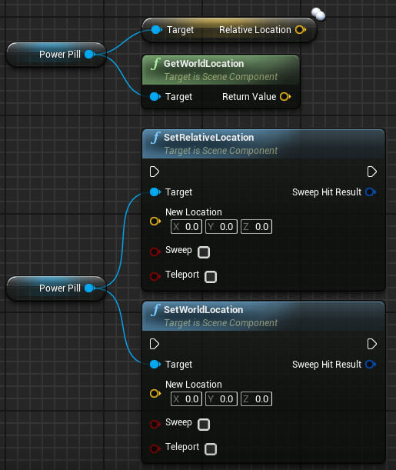
RELATIVE TRANSFORM FUNCTIONS
The position of the PowerPill component can be obtained in two ways: its relative location, which in this example is (0, 0, 70); or its world location, which in this case is the world position of the parent component (the Base component) plus the relative position of the PowerPill component.
The position of the component can also be defined in two ways using the functions SetRelativeLocation and SetWorldLocation. The SetRelativeLocation function defines a new position of the PowerPill component relative to the position of the root component, and the SetWorldLocation function receives as an input parameter a world coordinate and defines the position of the PowerPill component so that the sum of the position of the Base component and the position of the PowerPill component is equal to the specified world coordinates.

Slide 16
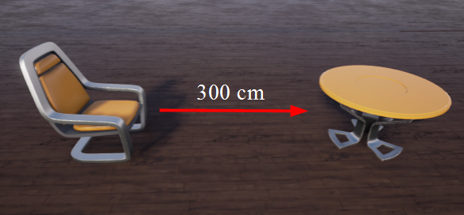
POINTS AND VECTORS
A vector is represented in Unreal Engine as a structure that contains the float values X, Y, and Z.
These values can be interpreted in various ways. One way a vector is used is to represent a point (or position) in 3D space. For example, every Actor has a variable called “Location” that returns a vector value.
Vectors are also used to represent movement. In the example on the right, in order to guide a robot to go from the chair to the table, two pieces of information are needed: the direction in which the robot should move and the distance.
Both the direction and the distance can be gathered into the vector: “300, 0, 0”.

Slide 17
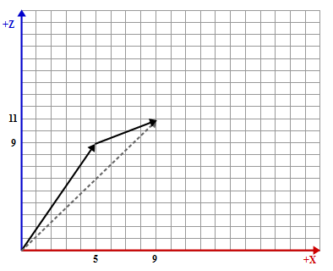
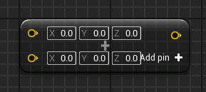
VECTOR ADDITION
The sum of two vectors is determined by adding each of its elements.
An example:
V1 = (5, 0, 9) and V2 = (4, 0, 2)
V1 + V2 = (5 + 4, 0 + 0, 9 + 2)
V1 + V2 = (9, 0, 11)
The bottom image on the right shows the Blueprint operator for the sum of vectors.

Slide 18
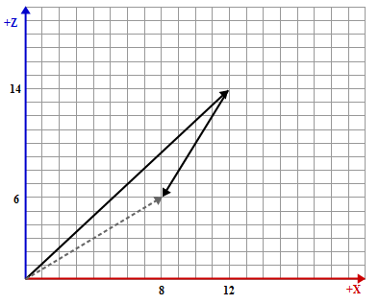
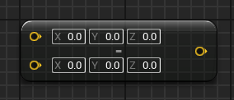
VECTOR SUBTRACTION
The subtraction of one vector from another is determined by subtracting each of its elements.
An example:
V1 = (12, 0, 14) and V2 = (4, 0, 8)
V1 – V2 = (12 – 4, 0 – 0, 14 – 8)
V1 – V2 = (8, 0, 6)
The image on the right shows the Blueprint operator for the subtraction of vectors.

Slide 19
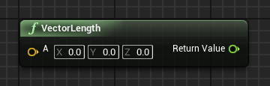
LENGTH OF A VECTOR
The length or magnitude of a vector can be calculated using the Blueprint function seen in the image on the right.
The value can be used to represent the distance between two points.

Slide 20
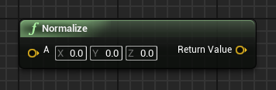
NORMALIZING VECTORS
Vector normalization is used to find a unit vector. The unit vector has a length equal to “1”.
A normalized vector is often used when only the direction needs to be indicated. Some calculations should use only a normalized vector.
You can make a character magnet with this!

Slide 21
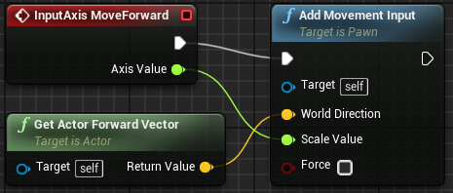
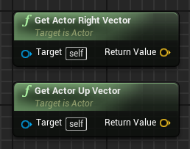
GET ACTOR FORWARD VECTOR
The Get Actor Forward Vector function returns a normalized vector (length = 1) that represents the direction an Actor is pointing in.
In the top image on the right, the InputAxis MoveForward event uses the Get Actor Forward Vector function to move the player forward or backward based on the value of the Axis Value parameter.
For example, using the standard “WASD” keys for movement, pressing the “W” key sets the value of the Axis Value parameter of the InputAxis MoveForward event to “1.0”, while pressing the “S” key sets the value to “–1.0” to reverse the direction.
There are two similar functions that provide vectors representing other directions: the Get Actor Right Vector function and the Get Actor Up Vector function, as seen in the bottom image.

Slide 22
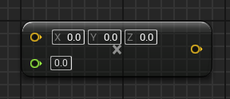
SCALAR VECTOR MULTIPLICATION
Multiplication of a vector by a scalar value is done by multiplying each of its elements by the scalar value.
This operation changes the length of the vector.

Slide 23
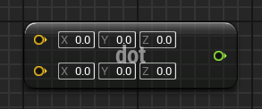
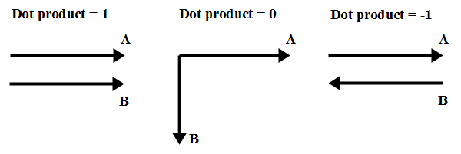
DOT PRODUCT
A dot product can be used to verify the relationship between two vectors, such as whether they are perpendicular or parallel.
If the two vectors are normalized, the dot product is equal to the cosine of the angle formed between the vectors and can range from –1 to 1.
The image on the right shows some examples of a dot product between two vectors.
You can make an entrance direction check (back/front) for level streaming with this!

Slide 24
SUMMARY
This lecture explained transforms, vectors, and world coordinates.
It also showed how to use vector operations and functions.

